Slide 1
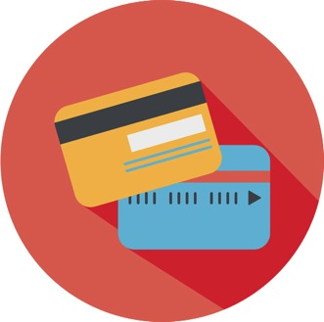
A Consumer’s Guide to Choosing a Prepaid Card
A project of Consumer Action | www.consumer-action.org
Funding provided by Visa Inc.
Notes:
Welcome participants and introduce yourself.
If you have a small group, you can ask individuals to introduce themselves (or, if time permits, ask them to pair off with someone seated near them and then introduce each other to the group) and tell you what they hope to get out of the training. In a larger group, invite a few volunteers to share their expectations. On your whiteboard or easel pad, jot down some of the specific things participants mention. You can come back to this at the end of the class to make sure you’ve covered these points. (This activity is designed to serve as a brief icebreaker. It will also give you an idea what participants’ expectations and needs are.)
Review the contents of participants’ packets. Ask the class to take a look inside their packets and make sure they have all the materials needed.

Slide 2
What you will learn
What a prepaid card is and how it works
The most common prepaid card fees and how to avoid or reduce them
How to shop for and choose a prepaid card
Where to find more information
Notes:
Consumers have many options for how they pay for things, one of which is the general purpose reloadable prepaid card.
Introduce the general topics (slide bullets) that will be covered so that participants know what they can expect to learn during the seminar.

Slide 3
Payment card comparison
Credit cards
Debit cards (checking account)
Prepaid cards
Notes:
In addition to all payment card options being safer than cash, each has its own advantages and disadvantages. Compare options so that you can choose the best one for your needs and goals.
Credit cards: Advantages: They allow you to borrow money to make purchases or get cash all over the world. Many offer rewards (airline points, cash back, etc.) and other cardholder benefits (free roadside assistance, purchase protection, etc.). All offer strong consumer protections under federal law. If you repay the money you spend in the first billing cycle, you can avoid finance charges (except on cash advances, which start accruing interest immediately). Managing a credit card responsibly can help you build or improve your credit score. Disadvantages: You pay interest on the money you borrow if you don’t pay it all back in the first billing cycle. Cash advances incur a fee and begin accruing interest immediately. In addition to finance charges, there may be other fees (annual fee, late fees, etc.). Not everyone has the credit history or income to be approved for a credit card. Mismanaging a credit card could result in a large debt, high financing costs and damage to your credit score.
Debit cards: Advantages: They can be used at the same places credit cards are accepted. Because the money spent comes out of your checking account, debt and finance charges are not an issue. You have the option to write checks, which can be useful for paying bills, individuals or merchants who only take cash or check. Disadvantages: While you won’t incur finance charges, you can still be assessed fees for account “maintenance,” overdrafts, out-of-network ATM use, etc. Using a debit card doesn’t help you establish or improve your credit, and debit cards generally don’t offer the rewards programs and cardholder benefits that credit cards do. They do offer some strong consumer protections, but a credit card is still a better option for many purchases. Your ability to cover a financial emergency is limited by your account balance.
Prepaid cards: Advantages: General purpose reloadable prepaid cards are available to virtually anyone, regardless of credit history or income. They can be reloaded and used for as long as you choose, in many of the same ways as a checking account debit card (to make purchases, pay bills and get cash). If you avoid a card that allows overdrafts, you can’t overspend and incur overdraft fees. Since you’re not borrowing money, prepaid card use does not result in debt or finance charges. Many cards can be used internationally. Disadvantages: Prepaid cards don’t help you establish or improve your credit (which means that whenever you do need credit, you'll pay more for it—if you're even able to obtain it). Even prepaid cards that don’t allow overdrafts still charge a variety fees, which can range from reasonable to exorbitant and aren’t always clearly disclosed. Though many prepaid cards voluntarily offer some consumer protections, they are not required by law, so they can be rescinded at any time. Because you can’t spend more than the balance on the card, you might not be prepared to cover an emergency expense. They tend to be more expensive than a low-cost, consumer friendly checking account that is managed wisely (no overdrafts or excessive ATM fees).

Slide 4
Is a prepaid card right for you?
Notes:
Whether or not a prepaid card is a good choice for you depends on your answers to the following questions:
Is a checking account an option for me? If you can’t get (due to a negative banking history) or don’t want a checking account, then a prepaid card can be a good alternative. However, having a checking account is generally a good financial goal because it offers better consumer protections than a prepaid card (unless and until new rules require the same federal protections on prepaid cards), typically costs less than a prepaid card if managed wisely, and allows you to establish a relationship with a financial institution that could prove useful when you need a loan or other financial product or service.
Is my goal to build or improve my credit? If the answer is yes, then a credit card would be the only option. This, by the way, is a good goal for anyone who plans get a home mortgage, finance a car purchase or, depending on your state, purchase auto insurance (better credit, better rates).
Do I want to be able to use the card to make reservations? While you may be able to pay the final bill with your prepaid card, you might not be able to use your card to make reservations with airlines, hotels and car rental companies.
Is it important for me to be able to provide a card with spending limits to a teen, nanny, etc.? Prepaid cards provide a tool for distributing an allowance, spending money or other limited funds without being concerned that the card user could overspend or accumulate debt. (There may be a fee for each card on an account.)

Slide 5
How prepaid cards work
Loading/reloading funds
Making purchases
Getting cash
Paying bills
Notes:
Before you purchase a prepaid card, you should understand how they work.
Loading/reloading: Depending on the card, you may be able to load and reload the account via direct deposit of your income (paycheck, benefits payments, etc.); with cash at a network location (such as a Western Union agent, Walmart store or bank branch); by checking or savings account transfer; or from a PayPal account. Not all cards allow all reload methods. Make sure the card you choose allows you to reload in the ways you want. Reload fees, if any, vary. It’s easy to find cards that allow direct deposit with no fee. Many even reduce or waive the monthly maintenance fee if you set up direct deposit. There may be limits on the amount you can deposit into your card account per day, the number of deposits you can make per month or the balance you can maintain, depending on the card issuer’s policies.
Making purchases: As long as there is money in your account, you can use your card to make purchases anywhere that accepts cards with the same logo (Visa, MasterCard, Discover, American Express). You can make purchases in person, online or by phone. When making a purchase in person, you may be given the option for the transaction to be “credit” or “debit.” In either case, the money will be deducted from your account balance. But there may be a difference in the fee, if any, for the two different transaction types. And “credit,” which requires a signature rather than a PIN (debit), may offer greater consumer protections and/or rewards. Understand the fees and the policies around both types of transaction so you can make the best choice each time you use your card. There may be limits on the amount you can spend with your card per day, week or month, depending on the card issuer’s policies.
Getting cash: You can get cash at ATMs, from bank tellers and at grocery stores and some other merchants when you select “debit” and request “cash back” while making a purchase. There may be a fee for ATM and/or teller cash withdrawals. “Cash back” at a merchant typically is free (though some cards do charge a transaction fee). There may be limits on the amount of cash you can withdraw from your card account per day, week or month, depending on the card issuer’s policies.
Paying bills: You can provide your card number to pay bills for creditors, utilities, etc. that accept card payments. Many cards also allow you to set up “payees” within your online account and schedule individual or recurring payments to virtually anyone. The card issuer may charge a fee for this, but many offer the bill-pay service for free.

Slide 6
Overdraft coverage
Pushes account into the “red”
A fee for each overdraft
Avoid!
Notes:
Overdraft coverage on a prepaid card allows you to spend more than your account balance. The card issuer will assess a fee each time you do (as much as $15 per overdraft or more). An overdraft option is not common on prepaid cards, but it does exist. Choose a card that doesn’t allow overdrafts and that doesn’t charge a fee if one inadvertently occurs (a possibility, though relatively uncommon). Being able to take your balance into negative territory defeats one of the greatest benefits of using a prepaid card: the inability to spend more than you have. And it can be very expensive.

Slide 7
Consumer protections
Limited liability
Dispute resolution
Insurance
Statements/activity
Notes:
There are no federal laws or regulations to protect general purpose prepaid card users the way credit and debit card users are protected. However, the prepaid card you choose may voluntarily offer some similar consumer protections. (Note: Payroll cards and government-issued electronic benefit transfer (EBT) cards generally do offer strong protections similar to those provided on checking account debit cards under federal and state law.)
Here are some policies and protections to look for on general purpose reloadable prepaid cards:
A limit of $50 on your responsibility for unauthorized transactions or, even better, “Zero Liability”
A dispute resolution process that requires the card issuer to investigate errors you report, respond in a timely manner and, in the case of a lengthy investigation, credit the disputed amount to your account until the investigation is completed
FDIC (or NCUSIF for credit unions) insurance or protection under state law against loss of your balance due to failure of the financial institution holding your account’s funds (Note: FDIC/NCUSIF offers far greater protection for consumers than state money transmitter laws.)
A monthly statement or easy, free online access to account activity
The Consumer Financial Protection Bureau (CFPB) has proposed strong new rules that would mandate federal consumer protections for all prepaid card users. The proposal would require prepaid card companies to limit consumers’ losses when funds are stolen or cards are lost, investigate and resolve errors, provide free and easy access to account information, and adhere to credit card protections if a credit product (i.e., overdraft coverage) is offered in connection with a prepaid account. The CFPB is also proposing new prepaid disclosures that would give consumers clear information upfront about the costs and risks of prepaid products. The rules are expected to be established in late 2015, though they most likely would not take effect immediately. Until that happens, be aware of the limitations and the variation in policies from card issuer to card issuer. (Get details about the proposed rules at the CFPB website: www.consumerfinance.gov/newsroom/cfpb-proposes-strong-federal-protections-for-prepaid-products/.)

Slide 8
Prepaid card fees
Notes:
Like other financial accounts, prepaid cards assess fees for certain activities. Being familiar with the potential fees and understanding what fees (types and amounts) are typical will help you choose a good card. Understanding how to reduce fees or even avoid them entirely will help you make money-saving choices when purchasing a card and using your account.
Potential fees:
Purchase and activation (initial load) fees: One-time charges when you obtain the card; they can range from $0 to $30 or more, combined. Many cards don’t charge an activation fee, and you can find cards, especially online, without a purchase fee. But watch out for cards that make up for that by assessing a high monthly service fee or transaction fees.
Reloading fee: Assessed for adding funds to your account; they can vary widely, from $0 to $5 or more per reload, depending on the source of funds (credit card or bank account transfer, cash at an agent, direct deposit, PayPal). A third-party fee could be charged by a retailer or other business that accepts in-person loads on behalf of the card issuer. Cards that charge this fee sometimes waive it if you use direct deposit or load a certain amount onto the card for the month. Otherwise, try to find a card that either doesn’t charge a reloading fee, offers ways to avoid or reduce it, or charges a relatively low fee.
Monthly service (maintenance) fee: Can be as much as $9.95/month, though some cards don’t charge anything. Many cards waive or reduce the monthly fee if you choose a plan that charges a purchase transaction fee, which could save infrequent card users money. Of those cards that assess this fee, as many as half reduce or waive it if you use direct deposit to reload or if you meet a minimum monthly reload requirement (though minimums can be quite high.)
Purchase transaction fee: A fee—say, 49¢ to $2—that is charged for each purchase transaction; sometimes applied to either “debit” (PIN) transactions or “credit” (signature) transactions rather than both types. Many cards don’t charge a transaction fee for customers who pay a monthly fee, which could save frequent card users money. Don’t pay both a monthly maintenance fee and a purchase transaction fee. If you choose to pay a purchase transaction fee, make sure there is a monthly limit (say, $10), after which you don’t pay any fees for additional transactions.
Declined transaction fee: Assessed by some cards if you try to make a transaction without sufficient funds in your account and you don’t have overdraft coverage. Not all cards charge this fee—look for one that doesn’t. If your card does, make sure you know your balance at all times so that you can avoid having a transaction declined.
Overdraft fee: Assessed when you spend more than you have in your account and the card allows overdrafts—not an option on most cards. The best way to avoid this fee is to choose a card that doesn’t allow overdrafts. If your card does allow overdrafts, ensure you don’t overdraw your account by always knowing your available balance.

Slide 9
Fees (continued)
Notes:
Here are more potential fees and ways to reduce or avoid them.
ATM withdrawal fee: Charged for cash withdrawals from ATMs; some card issuers charge it only on out-of-network ATMs and/or only after you’ve used any free withdrawals the issuer may allow. Virtually all prepaid card issuers charge a fee (usually $1 to $3) for withdrawing money from an out-of-network ATM, and it’s likely you’ll also pay a surcharge assessed by the owner/operator of the ATM. Look for a card that offers at least one or two free ATM withdrawals per month (preferably more) at conveniently-located network ATMs. Avoid using out-of-network ATMs. An easy way to avoid ATM fees is to get cash back when making a “debit” purchase at a grocery store or certain other merchants. But remember that choosing "debit" can also mean you won't be able to rely on consumer protections that may be available only when you choose "credit."
ATM balance inquiry fee: This fee, typically ranging from 49¢ to $2, is charged for checking your balance at an ATM. You shouldn’t have trouble finding cards that allow free in-network ATM balance inquiries. But virtually all cards allow you to sign up to access your account online, where you can check your balance as often as you want for free.
Bill-pay fee: Assessed when you pay a bill with your card; many cards offer free bill payments. If you plan to use your card to pay bills, look for a card that doesn’t charge a fee for bill payments—they’re out there. If you can’t find a card without a bill payment fee, choose a card that charges a relatively low fee compared to other cards. (Note: Bank-issued prepaid cards may not offer a bill-pay feature. If this is important to you, confirm before you choose a card. Alternatively, you can provide your card account number to pay bills for creditors, utilities, etc. that accept card payments.)
Funds transfer fee: If you need to transfer money to another account, there may be a fee. If you plan to transfer funds regularly, look for a card that doesn’t charge this fee.
Foreign transaction and currency conversion fees: Charged for using your card outside the U.S. It’s not uncommon for card issuers to charge one or both fees when you use your card internationally. If you plan to use your card outside the U.S., choose a card with lower-than-average fees in this category.
Inactivity fee: Charged if you don’t use your card for an extended period (typically three months or longer). The fee—both the amount and the period after which it is assessed—can range widely. If you think there might be periods when your card goes unused, consider this fee when shopping around. Make sure that the inactivity fee does not exceed the regular monthly service fee or the monthly per-transaction fee limit. Many cards that assess an inactivity fee won’t do so if you have at least made a balance inquiry, an ATM withdrawal or a call to customer service once during the month (even if you haven’t made a purchase).
Paper statement fee: Many, if not most, cards charge a fee to send you a paper statement—as much as $5.95 or more. You can easily avoid this fee by checking your statements and account activity online. Don’t choose a card that charges a fee for accessing your account online.
Customer service fee: You shouldn’t have to pay a fee to talk to a live customer service representative, but some card issuers charge for that. There are plenty of cards that don’t charge a fee to talk to a live customer service representative, so shop around.
Other fees: Miscellaneous other fees—for example, a fee to replace a lost card or a fee to close the account (each of which can be $10 or more, though many cards charge less or even nothing)—are either avoidable or assessed so infrequently as to not be a significant factor when choosing a card (as long as you’re not likely to lose your card and not planning to close the account after a short period).
In addition to the types and amounts of fees, the “transparency” of the fees is very important. Any card you choose should list all potential fees very clearly. Because card packaging might not allow disclosure of all fees, it’s best to check the card’s website. Only by knowing exactly what fees you could be charged can you make a well-informed choice.

Slide 10
Rewards and cardholder benefits
Notes:
Some prepaid cards now offer rewards programs (points, cash back, etc.) similar to those offered by credit cards, as well as cardholder benefits such as roadside assistance, traveler’s assistance and “purchase protection.”*
Beware of cards that offset the cost of these benefits with high fees—they are not cost effective.
Terms on rewards programs and cardholder benefits vary, and there are usually exclusions, so check your card agreement carefully for details. Research the availability of and restrictions on these benefits before you select a prepaid card if they are important enough to you to influence your decision.
*Purchase protection typically extends the standard manufacturer’s warranty; reimburses you for lost, stolen or broken items purchased with the card; and/or credits you the difference between what you paid for an item and a lower advertised price within a certain time frame.

Slide 11
Savings feature
Notes:
Some prepaid cards offer a savings feature. If you have low savings and are unable to open a traditional bank or credit union savings account, a prepaid card with a savings feature may be an option to consider. Not all prepaid cards offer such a feature, so you’d have to shop around.
Be aware that those prepaid cards that do allow you to set aside money sometimes put a cap on the amount you can accumulate. Or, they may require you to maintain a minimum balance or make automatic monthly deposits in order to open an account or earn interest, or put a cap on the portion of your savings that can earn that eye-catching interest rate. And since you can only make deposits and withdrawals via the prepaid card, you could incur fees for every savings-related transaction—something to watch out for.
Also, unless you have a written guarantee that any account funds that are lost or stolen would be replaced, you could lose all your savings. Even if your prepaid card has a policy of reimbursing lost funds, it is voluntary and could change at any time. (Federal rules requiring reimbursement are being considered, but have not been approved or implemented yet.)
If you can manage it, open a traditional savings account at a bank or credit union. Such an account would offer the added benefit of a relationship with a financial institution that might be able to help you open other types of accounts or take out loans and build credit in the future.

Slide 12
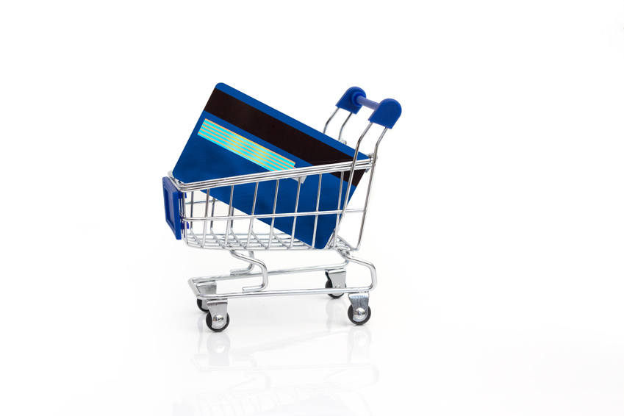
Shopping for a prepaid card
Notes:
Prepaid cards typically are sold online or through retailers. Many banks now also offer prepaid cards. You should research your options carefully rather than choosing a card off the rack or responding to a marketing pitch. Before purchasing a card at a retailer, visit the card issuer’s website to get the full list of terms and fees, which are too lengthy to fit on card packaging. (You might be able to avoid a purchase fee by buying the card online rather than in a store.)
The “cardholder agreement” outlines the terms and conditions under which a card is issued and should include everything you need to know about the card’s fees (including how you might be able to reduce or avoid them), any features and benefits the account offers, and how to exercise your consumer rights and protect your privacy.
“Test drive” the card’s customer service by emailing a question and calling the toll-free number.
When comparing fees, make sure you consider what the card will cost you the way you intend to use it. For example, if you rarely or never travel outside the U.S., then foreign transaction and currency conversion fees shouldn’t factor heavily into your cost analysis. Likewise, if you only plan to use the card for three or four purchases a month, then a card with a mandatory $10 monthly maintenance fee won’t be as attractive as one that gives you the option to instead pay a low per-purchase fee. Choose a card that makes it easy to keep costs low. And be sure that you can reload the card conveniently, the way you want to, at no cost and that there are free in-network ATMs near your home or work.
After identifying which card has the features you want at the lowest cost, submit your application. Typically, a card issuer will ask for identifying and contact information such as your name, address, birthdate and a government-issued identification number (Social Security number (SSN), individual tax identification number (ITIN), passport number, driver’s license number or matrícula consular number). If you plan to load your new card from a bank account, credit card or other source, you’ll need to provide that information, too. You can expect to receive your card in about one to two weeks. Follow the activation and registration instructions, and sign the back of the card.

Slide 13
Shopping tools
Notes:
Card comparison websites make it easy to shop around. But be aware that not all comparison sites reveal all available options in their search results. It’s best to use a few sites and then narrow down your list to a few cards for a side-by-side comparison.
Here are some websites that can help you compare your prepaid card options:
Bankrate (www.bankrate.com/credit-cards/prepaid-debit-cards.aspx)
CardHub (www.cardhub.com/prepaid-cards/)
CardRatings.com (www.cardratings.com/prepaid-cards.html)
Credit.com (www.credit.com/credit-cards/prepaid-cards/)
CreditCards.com (www.creditcards.com/prepaid.php)
CreditCards.org (www.creditcards.org/prepaid-debit-cards--2)
NerdWallet (www.nerdwallet.com/prepaid/)
Visa Clear Prepaid (www.visa.com/visaclearprepaid)
There are many other similar card comparison sites.
Consumer Reports and other publishers release prepaid card surveys periodically (www.consumerreports.org/cro/prepaid-cards/buying-guide.htm). You can also shop for cards at the Visa, MasterCard, Discover and American Express websites.
Instructor’s note: If possible, project one or more of these websites on your screen for the group to view together.

Slide 14
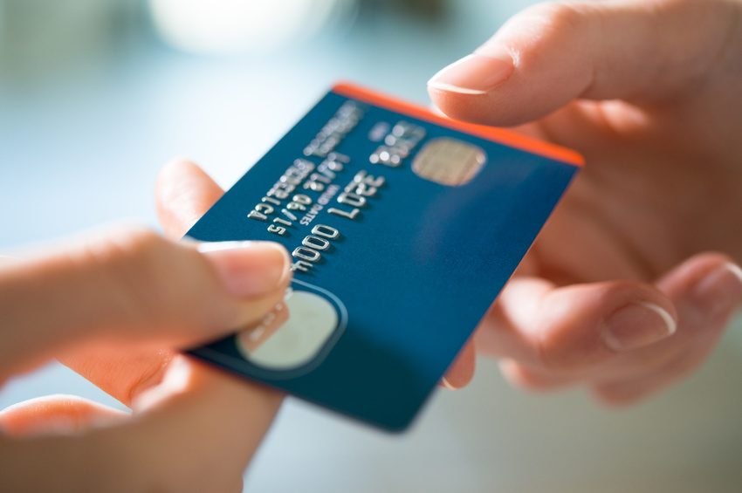
Using your card
Notes:
Once you’ve chosen your prepaid card account, turn your attention to using it wisely.
If you purchased your card at a retailer, the first thing you should do is register it, which means providing your personal information to the card issuer. Generally, registration is required to get your money back if the card is lost or stolen, to use direct deposit, to withdraw cash, to make purchases online (some merchants require a valid “billing” address), etc.
If you plan to have your income direct deposited to your prepaid card, set that up with your employer or other payer. Contact the card issuer if you need guidance.
Know if there are fees, rewards or consumer protections associated with one type of transaction or the other (debit/PIN vs. credit/signature) so that you can make a wise choice each time you use the card. (You will most likely receive the greater security protections normally extended to signature transactions even when you aren’t able or required to sign for the purchase (for online, phone and mail orders and some small-dollar transactions—usually under $25 or $50), but check with your card issuer.)
Plan ahead for getting cash so that you can avoid a fee either by visiting a free ATM or by making a purchase at a grocery store or certain other merchants where you can get “cash back” for free.
If you want to make a purchase that costs more than the balance on your card, ask the merchant before the transaction begins whether you can pay the remainder with another form of payment (cash, check or other payment card). This is called a “split tender” transaction and generally requires you to know the balance on your card (particularly important if you have a card that charges a declined transaction fee).
Plan ahead if you use your card for a transaction that could result in an “authorization hold” on some of your funds. For example, when you pay at the pump for gas, the card issuer typically puts a hold on funds to cover the estimated cost of the transaction. The hold tends to range from $50 to $125, and typically drops off within 24 hours, but could stay on for up to 72 hours. You can avoid a hold by handing your card to the cashier before pumping, and then retrieving the card afterward. Other businesses that place holds include restaurants (to cover the estimated tip) and hotels (to cover incidental charges to your room—phone and room service, for example—between the time you check in and check out). (Authorization holds are common on credit and debit cards as well.)
You can use most reloadable prepaid cards in other countries, but it’s best to check with the card issuer. Notify the card issuer before leaving the U.S. so that your account isn’t frozen as a fraud protection measure.

Slide 15
Managing your account
Set up online account / download app
Sign up for alerts
Monitor transactions
Check for changes
Notes:
Take advantage of technology to manage your account.
Register for an online account. This will enable you to view your transactions online, use the bill-pay service and more. If you plan to access your account from a mobile device (smartphone or tablet), download the app.
Sign up for text and/or email alerts that notify you if your balance is low, if there has been a large transaction, etc.
If paper statements are automatic and incur a fee, opt out and instead view your statement online.
Log in to your account regularly at the cardholder website to view transactions and the card balance.
To protect your account, always log out and close the browser or app when you are finished. Do not allow your password to be saved by the system.
Pay attention to notifications from the card issuer—they could announce important changes to your card terms. However, since there’s no requirement for prepaid card issuers to notify you of a change in terms, check the website regularly for change notices.
If you have not received a replacement card by the expiration date on your card and you want to continue using the account, contact the card issuer.

Slide 16
Resources
Consumer Financial Protection Bureau (CFPB) (www.consumerfinance.gov)
Federal Trade Commission (FTC) (www.consumer.ftc.gov)
Consumer Action (www.consumer-action.org)
KnowYourCard.org (www.knowyourcard.org)
Notes:
For specific questions about a particular card, contact the card issuer at the number on the card or on the card website. The following are sources of general information and assistance for cardholders and card shoppers.
Consumer Financial Protection Bureau (CFPB): www.consumerfinance.gov / 855-411-CFPB (2372)
The CFPB is tasked with creating and enforcing rules governing financial products and services, including prepaid cards. To find general information, visit the CFPB website and search for “prepaid cards.” You can also file a complaint against a card issuer or financial institution online (www.consumerfinance.gov/complaint/) or by phone.
Federal Trade Commission (FTC): www.ftc.gov / 877-382-4357
The FTC works for consumers to prevent fraudulent, deceptive and unfair business practices and to provide information to help spot, stop and avoid them. Materials offered by the agency helps consumers make wise choices.
Consumer Action: www.consumer-action.org / 415-777-9635 / hotline@consumer-action.org
Consumer Action offers free information and advice on choosing and using prepaid cards as well as many other personal finance, housing, privacy and consumer protection topics. Hotline counselors speak English, Spanish and Chinese. Connect with Consumer Action at facebook.com/consumeraction and follow the organization on Twitter @consumeraction.
KnowYourCard.org: www.knowyourcard.org
A project of Consumer Action and Visa, this online payment card rule book explains everything consumers need to know about using credit, debit, prepaid and gift cards safely and wisely.

Slide 17
Congratulations!
You’ve completed the training.
Consumer Action
www.consumer-action.org
415-777-9648
outreach@consumer-action.org
© Consumer Action 2015
Notes:
See lesson plan for the course evaluation form and instructions.
Thank participants for joining you today and ask them to fill out the evaluation form and leave it on a table or in a large envelope you provide. If you will be conducting other trainings at a specific future time, announce that now and encourage everyone to attend.

