Slide 1

When a collector calls:
An insider’s guide to responding to debt collectors
A project of Consumer Action, created with funding from CRC
© 2017
Notes:
This is a companion slide deck based entirely on the contents of Consumer Action’s publication “When a collector calls: An insider’s guide to responding to debt collectors.” This deck can serve as a visual aid and optional tool for educating consumers on the material in the publication.
The “insider’s guide” was written with input from an association of collectors. It provides tips for communicating effectively with a collector, exercising and protecting your rights and avoiding debt collection scams.

Slide 2
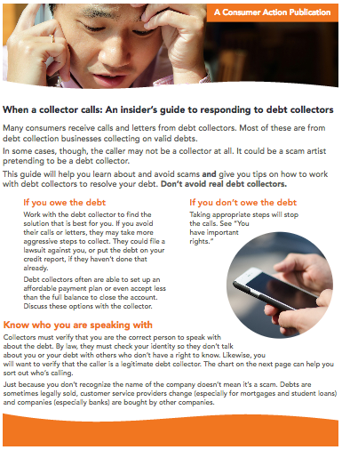

What consumers will learn
How to avoid scam artists posing as debt collectors
Tips for working with debt collectors collecting valid debts
When a collector calls: An insider’s guide to responding to debt collectors
Notes:
The insider’s guide has two key objectives:
(1) To help consumers avoid scams and (2) to provide consumers with tips on how to work with debt collectors to resolve debt.
The guide emphasizes: Don’t avoid real debt collectors.

Slide 3
Does consumer owe the debt?
If debt is owed | If debt is not owed
Work with collector to find a solution | Take steps to stop calls
When a collector calls: An insider’s guide to responding to debt collectors
Notes:
As explained in the guide:
If you owe the debt: Work with the debt collector to find the solution that is best for you. If you avoid their calls or letters, they may take more aggressive steps to collect. They could file a lawsuit against you, or put the debt on your credit report, if they haven’t done that already.
Debt collectors often are able to set up an affordable payment plan or even accept less than the full balance to close the account. Discuss these options with the collector.
If you don’t owe the debt: Taking appropriate steps will stop the calls. See “You have important rights.”

Slide 4
Know who is on the phone
Collectors will take steps to verify they’re speaking to right person
Consumers should also verify that caller is a legitimate debt collector
When a collector calls: An insider’s guide to responding to debt collectors
Notes:
Collectors must verify that you are the correct person to speak with about the debt. By law, they must check your identity so they don’t talk about you or your debt with others who don’t have a right to know. Likewise, you will want to verify that the caller is a legitimate debt collector. The chart on the next slide can help you sort out who’s calling.
Just because you don’t recognize the name of the company doesn’t mean it’s a scam. Debts are sometimes legally sold, customer service providers change (especially for mortgages and student loans) and companies (especially banks) are bought by other companies.

Slide 5
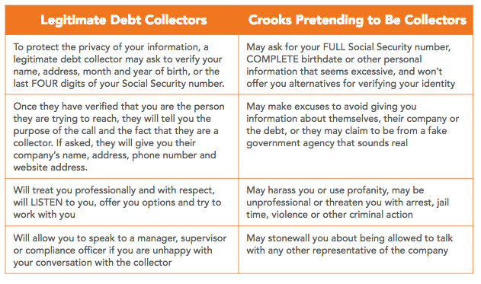
Sorting out who is calling
When a collector calls: An insider’s guide to responding to debt collectors
Notes:
This chart can help you sort out who’s calling.

Slide 6
Is the caller a crook?
If you suspect the caller is a crook:
  Ask for written information about the debt and the collection agency
  Tell the caller you won’t discuss the debt until you receive the letter
When a collector calls: An insider’s guide to responding to debt collectors
Notes:
No notes for this slide.

Slide 7
Consumer rights
Request verification of the debt, name and address of the original creditor within 30 days of validation notice
Dispute debt any time
Preferred communication method and best time to call
When a collector calls: An insider’s guide to responding to debt collectors
Notes:
You also have consumer rights when dealing with legitimate collectors:
You have the right to request verification (proof) of the debt, as well as the name and address of the original creditor. You must make your request in writing to the debt collector within 30 days of receiving a “validation notice.” (This validation notice, which must be sent to you within five days of the collector’s first contact, contains important information about the debt.) However, you may dispute a debt at any time. If you ask for verification (proof) of the debt and/or information about the original credit account, the debt collector must stop efforts to collect from you until they have responded.
If you prefer to be contacted in a different way (cell phone, text message, email, etc.) or at particular times, notify the collector of your preference in writing.
If you receive a collection letter in the mail, read it carefully. Unless you have reason to believe the letter is a fake, you should respond. Do not ignore collection letters.

Slide 8

Speaking with a debt collector
If you have proof that the collector and debt are real, you can discuss the debt
When a collector calls: An insider’s guide to responding to debt collectors
Notes:
Once you get proof that the caller is a real debt collector and the debt is yours, discuss your case and explain your situation.
The first time you speak with them about the debt, get a clear understanding of which debt they are calling about. Ask for the amount you owe (with details of fees, interest and the age of the debt).
In the next slide we explain why it’s important to ask about the age of the debt.

Slide 9
Statute of limitations
Collectors have limited number of years to sue
Limitations period varies by state
Federal Trade Commission’s “Time-Barred Debts” offers more information
When a collector calls: An insider’s guide to responding to debt collectors
Notes:
It’s important to know that debt collectors have a limited number of years—the statute of limitations—to sue you to collect. This period varies by state.
Learn more about these “time-barred debts” at the Federal Trade Commission’s website (https://www.consumer.ftc.gov/articles/0117-time-barred-debts).

Slide 10
Communicating with a collector
Present disputes and/or explain circumstances
Don’t be afraid to negotiate
Get repayment agreement in writing
When a collector calls: An insider’s guide to responding to debt collectors
Notes:
During the call with the collector, you might also discuss possible repayment options. Once you are comfortable it’s your debt and have a chance to review your finances, consider committing to a repayment plan that you can keep up with.
Tips for communicating with a collector:
• Present any dispute you may have with the debt and/or explain any circumstances that affect your ability to pay it.
• Don’t be afraid to negotiate if you owe the debt and can afford to pay something.
• If necessary, make an appointment for a follow-up call at a time that works for you.
• Make sure you keep the appointment, even if you are having trouble figuring out how to repay the debt. Being a “no-show” will not help your case and could open you up to a lawsuit or negative credit reporting.
• If you come to a repayment agreement, using a payment method you are comfortable with, ask the collector to put all details of the agreement in writing and give you a copy.

Slide 11
Tips for speaking with a collector
Stay calm
Keep detailed notes about phone calls
Save letters and emails
When a collector calls: An insider’s guide to responding to debt collectors
Notes:
Keep these tips in mind:
• Stay calm. Try not to raise your voice.
• Write down and keep details about all phone calls, including dates, times and topics discussed, and any letters or emails you receive.

Slide 12

Ceasing communications
If you can’t reach a repayment agreement, or don’t want debt collector to call, you can request in writing that calls stop
If notified you’re being sued, don’t ignore
Consider maintaining contact as better option
When a collector calls: An insider’s guide to responding to debt collectors
Notes:
• If you cannot reach an agreement for repayment, or you do not want the debt collector to call you for any reason, write to the debt collection company and ask it to stop calling.
• If you tell the collector to stop calling, it doesn’t mean the debt will go away. You may still get sued for the debt or it may be reported to the credit bureaus. (You must be informed when a lawsuit is filed. Never ignore such notices!) Staying in contact might be a better option.

Slide 13

Having trouble?
Complain to the company’s
compliance department
Complaints about
unresolved issues:
  Consumer Financial Protection Bureau (CFPB)
  State attorney general
  Better Business Bureau
When a collector calls: An insider’s guide to responding to debt collectors
Notes:
If you’re having trouble with a debt collector, submit your complaint and/or your request that collection calls stop directly to the company’s compliance department. If you are not able to resolve the issue directly with the collection agency, you can submit a complaint with:
• The Consumer Financial Protection Bureau (CFPB)
• Your state’s attorney general (the NAAG website provides a state directory)
• The Better Business Bureau
Additional resources:
You have a right to get your credit reports for free every 12 months at AnnualCreditReport.com. If you don’t know what debts you owe, this is a good place to start. Just be aware that not all past-due debts are reported to credit bureaus.
If you have unpaid debts, be aware of your rights so that you don’t miss out on available consumer protections. Learn more about the debt collection process and debtors’ rights in Consumer Action’s “Debtors’ Rights: Protecting yourself from debt collection lawsuits” and “The Fair Debt Collection Practices Act: How it restricts collectors and protects consumers.”

